Slide 1
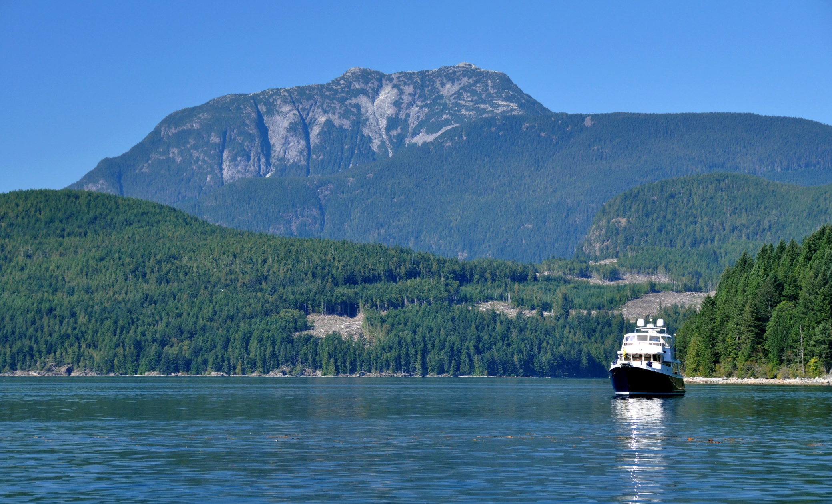

Discovery Islands
Visual Quality Objective
Conformance Review
Forest Sector & Tourism Sector Workshops
Campbell River
January 2014
Presented by:
Lloyd Davies, RPF
Visual Resource Management Specialist
Coast Forest Region
Ministry of Forests, Lands & Natural Resource Operations

Slide 2
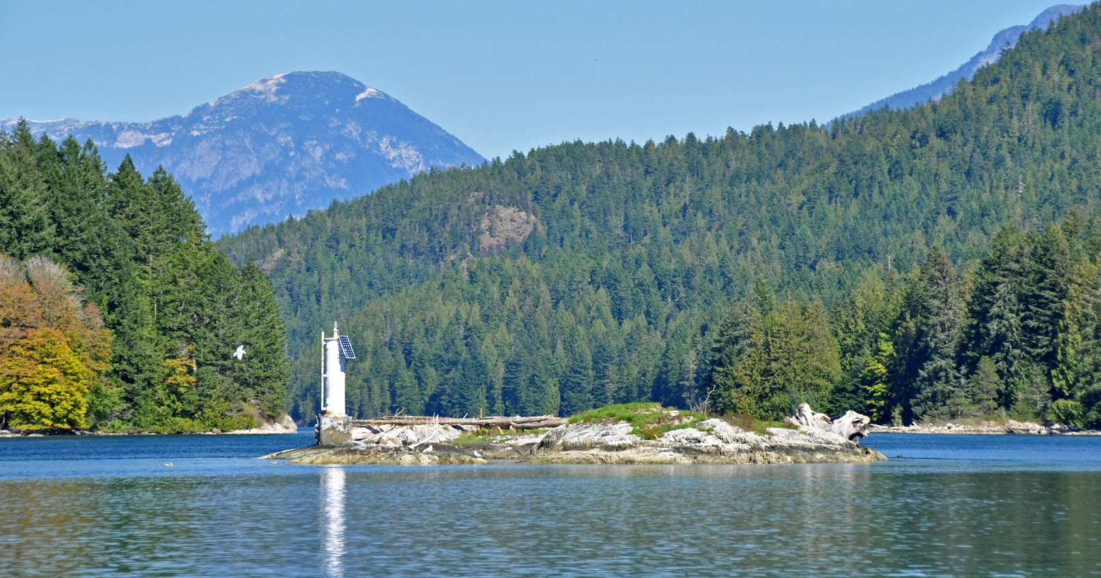
Presentation Objectives:
Overview of VQO Conformance Review.
Purpose and reason for the review.
When, who, and how the project was completed.
Summarize the findings... show some examples.
Provide some recommendations.
Address any questions or concerns.
Entrance to Whiterock Passage

Slide 3
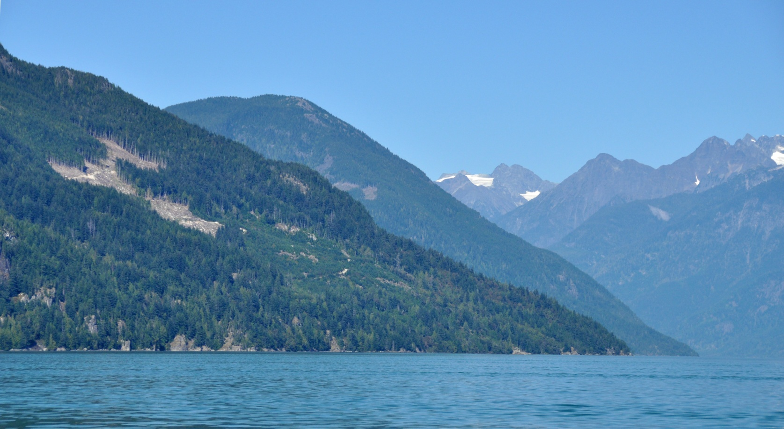
Purpose of the VQO Conformance Review
Strategic overview of meeting established VQOs ... Report Card.
Fulfill government obligations to monitor forest resource practices.
Validate concerns being expressed by DIMTG.
Qualitative not quantitative (ie. statistical) ... caution interpreting numbers
Prepare a report and share findings.
Butte Inlet

Slide 4
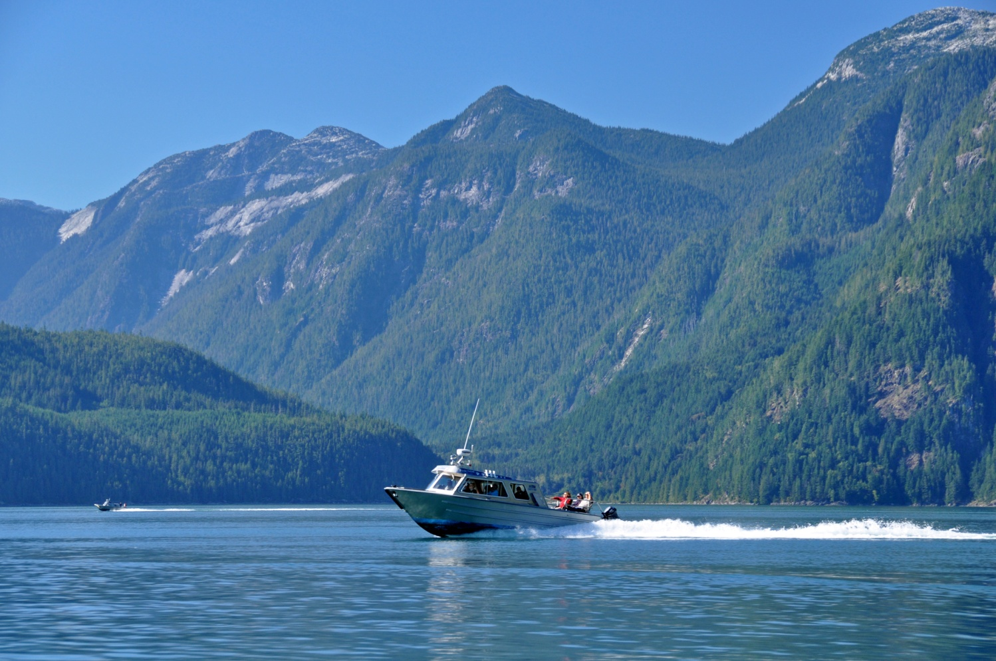
Joint Sponsorship:
Ministry of Forests, Lands, & Natural Resource Operations
Ministry of Jobs, Tourism & Skills Training
Wildlife & scenic tourism boats, Butte Inlet

Slide 5
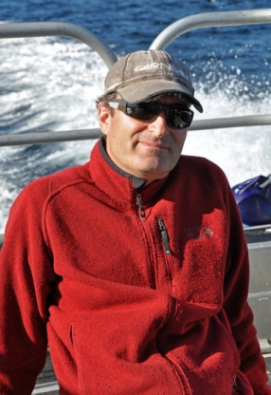
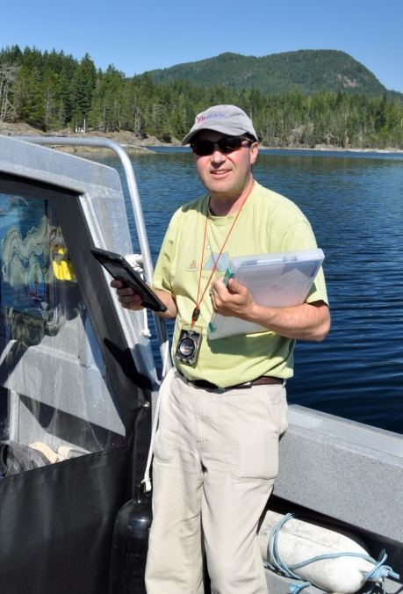
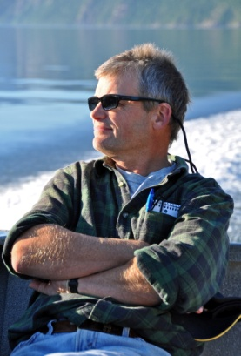
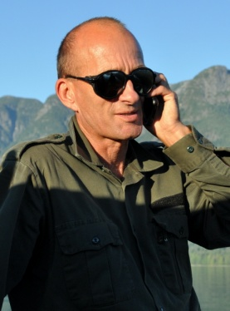
VQO Conformance Review
When: September 4-15, 2013
Time: 4 days/40 hours
Who: 4 MFLNRO staff ....
John Andres, RPF
Stewardship Officer
Campbell River District
Blake Fougere, RPF
Stewardship Officer
Sunshine Coast District
Lloyd Davies, RPF
Visual Resource Specialist
Coast Forest Area
750+ digital photographs
Gerard Nachtegaele, RFT
Resource Technologist Tenures
Sunshine Coast District

Slide 6
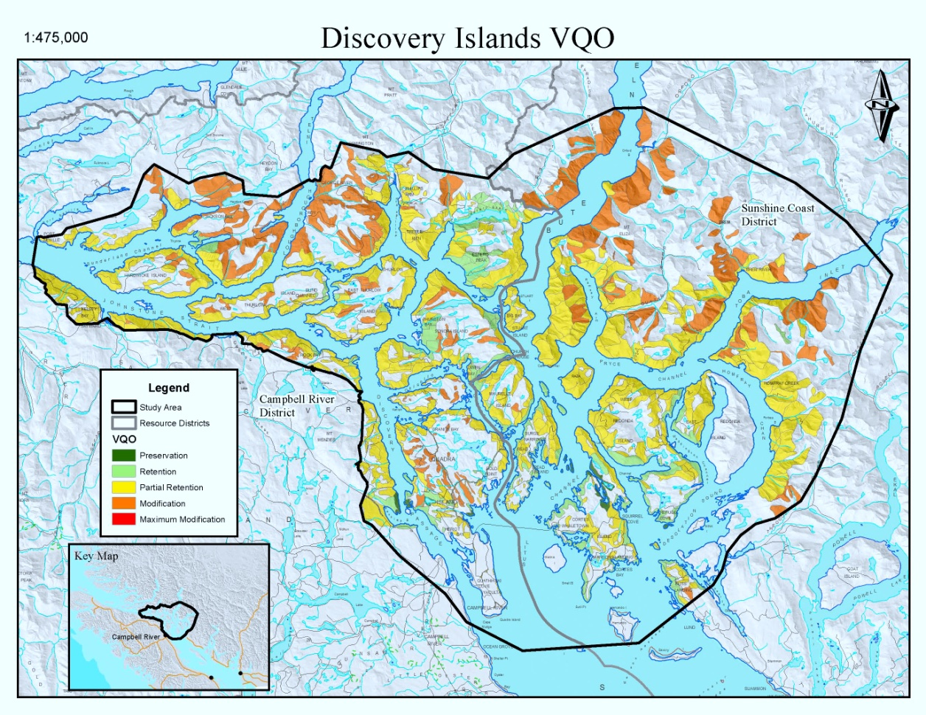
VQO Status
Sunshine Coast May 1997
Campbell River Dec. 2005
Discovery Islands area by VQO Class
VQO Total ha %
P Preservation 1,258 0.7
R Retention 19,997 12
PR Partial Retention 102,621 60
M Modification 48,048 28
MM Maximum Modif. 0 0

Slide 7
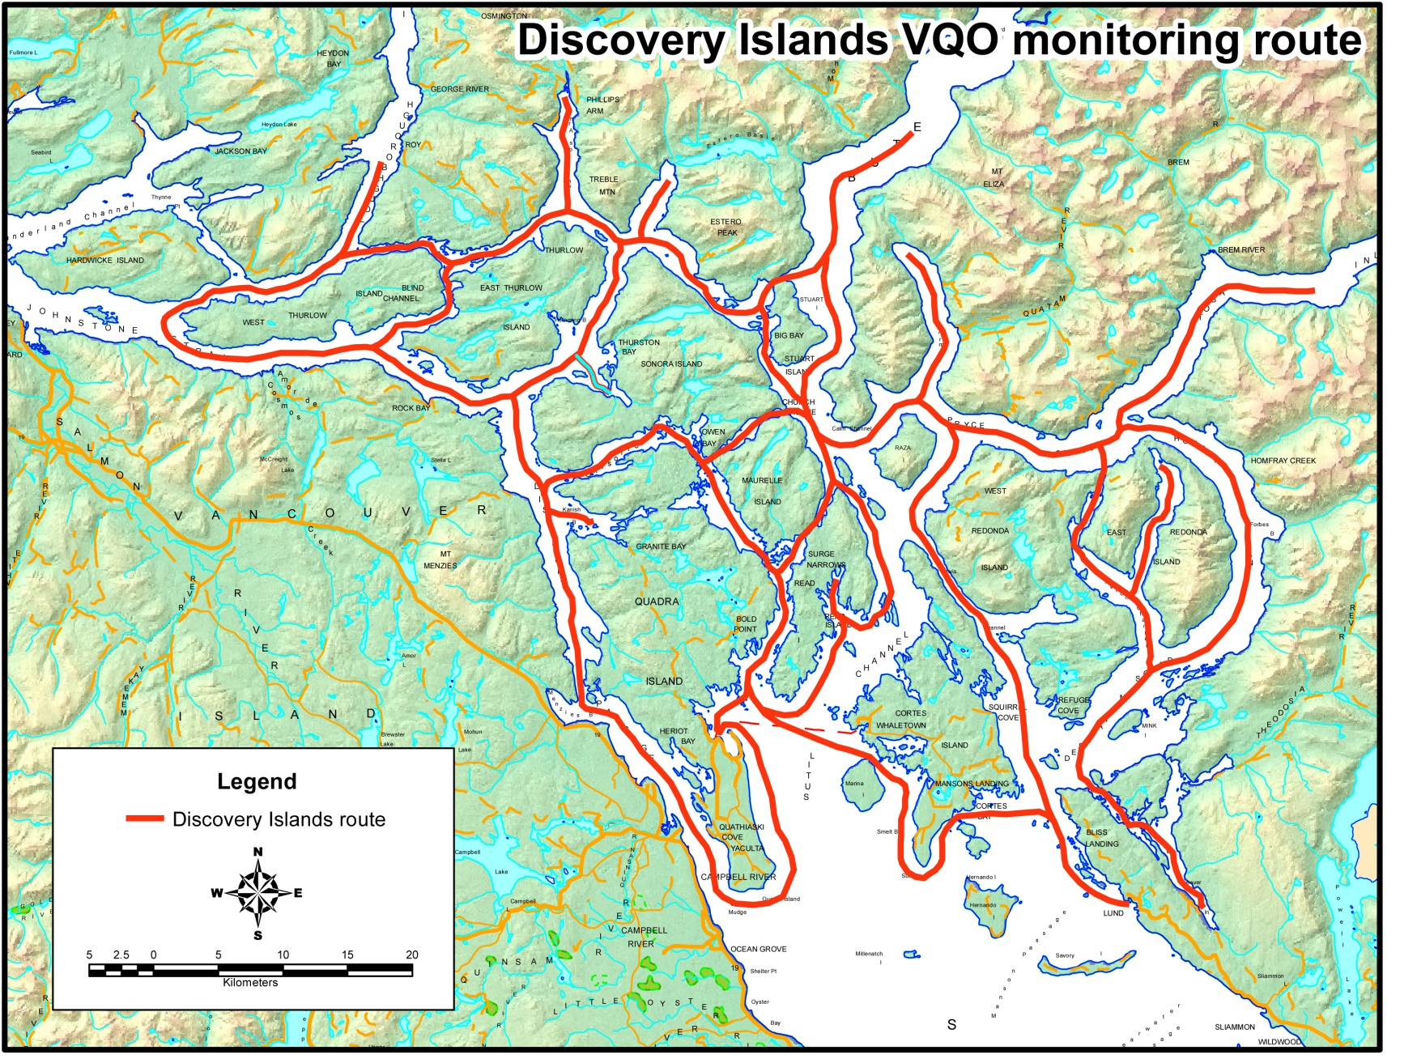
All main travel routes were reviewed.

Slide 8
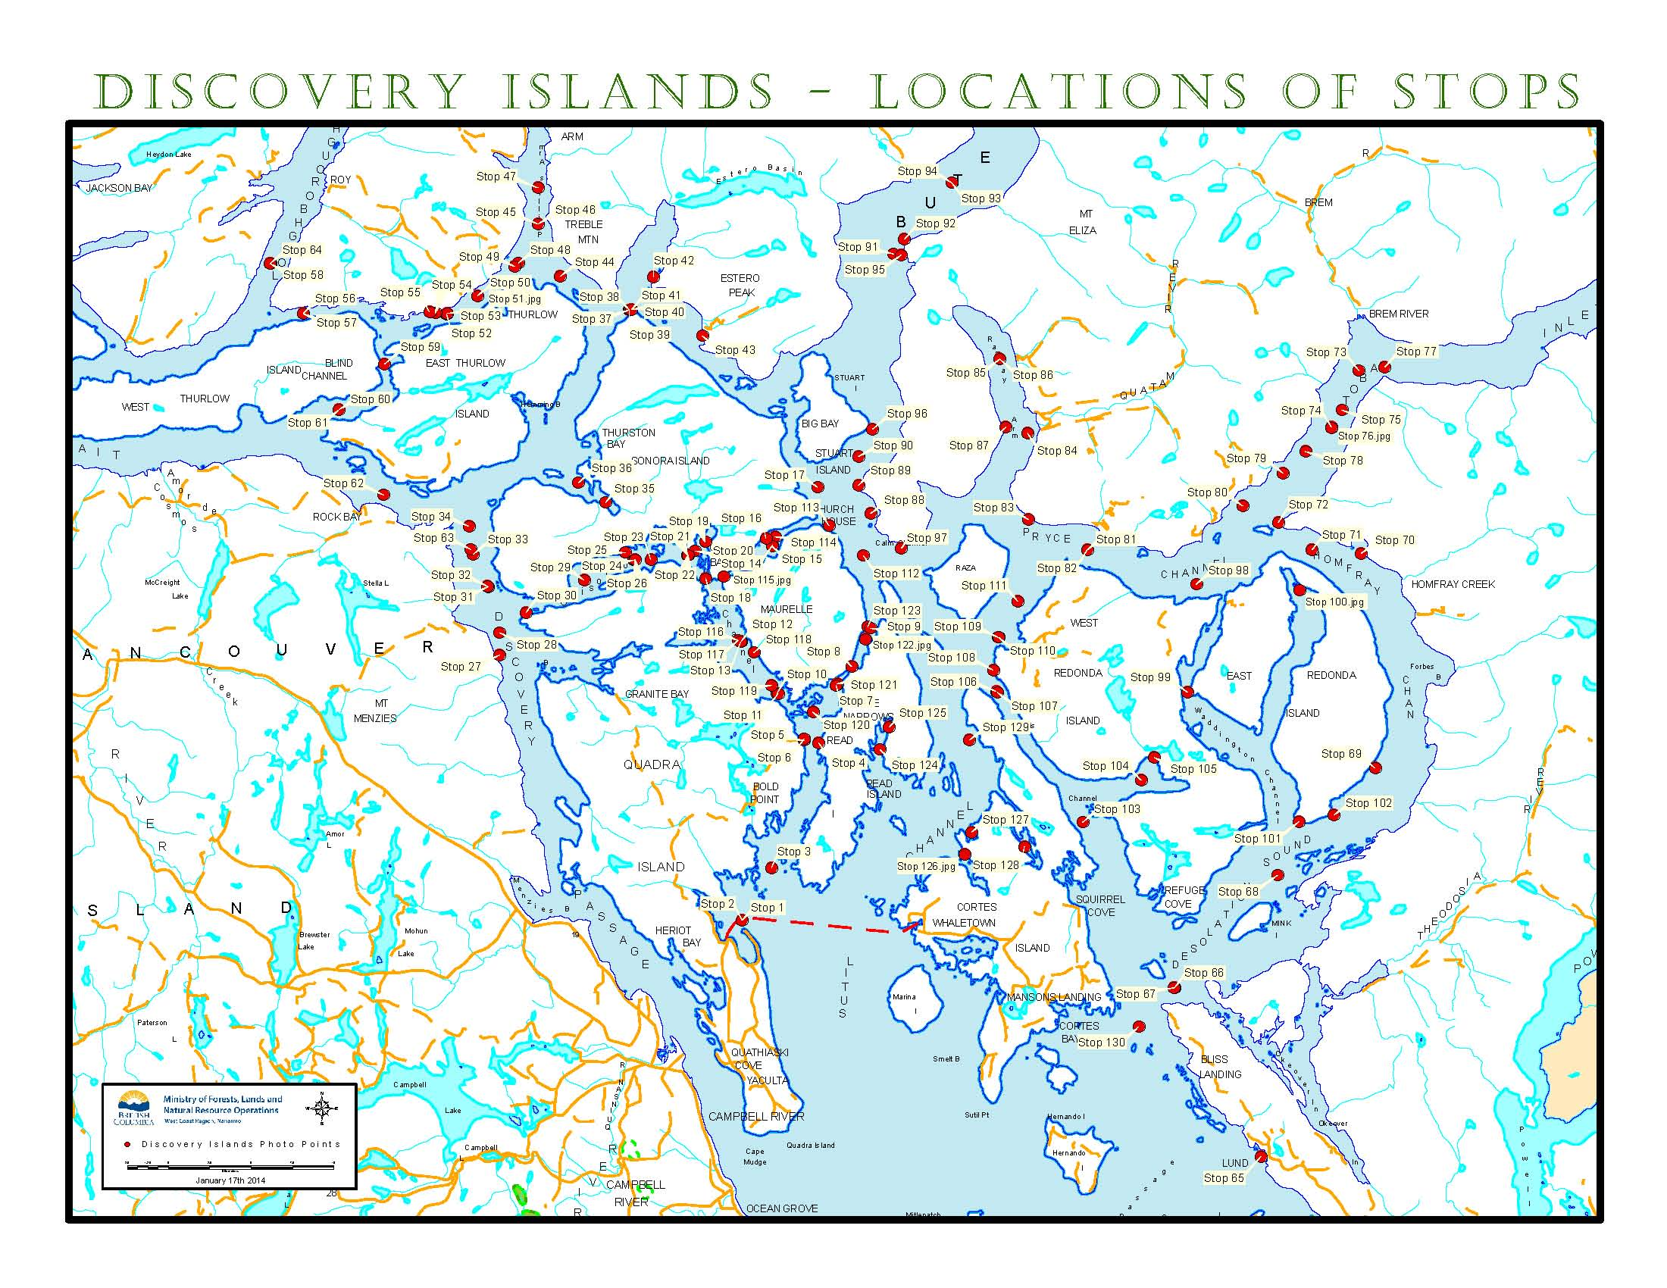
Report documents 130 “Stops”.

Slide 9
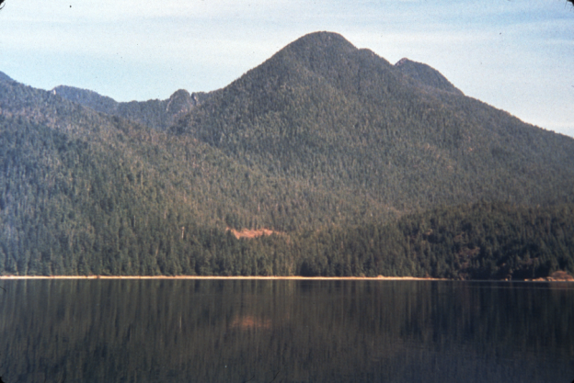
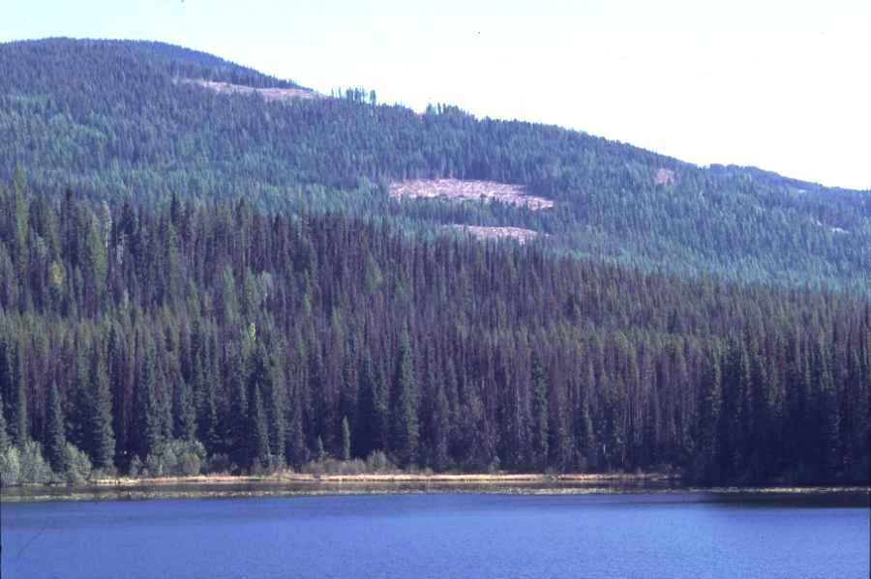
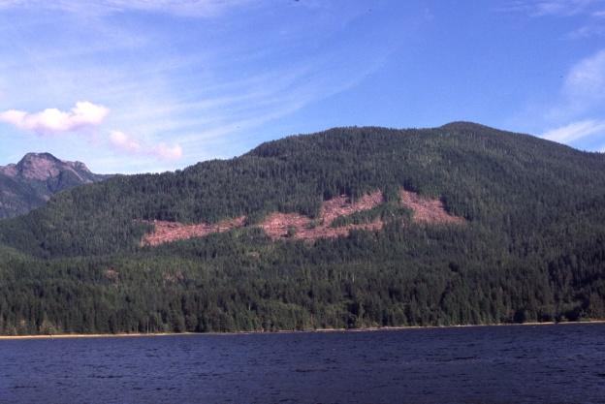
Visual Quality Objectives
VQOs are management objectives established by the DM under the Government Action Regulation Sect 7(2), grand parented under FRPA, or set through orders under the Land Act. They are used to reflect society’s desired level of visual quality on the landscape.
The Forest Planning and Practices Regulation S.1.1 defines 5 categories of alteration:
Preservation, Retention, Partial Retention, Modification & Maximum Modification.
Retention
Partial Retention
Modification

Slide 10
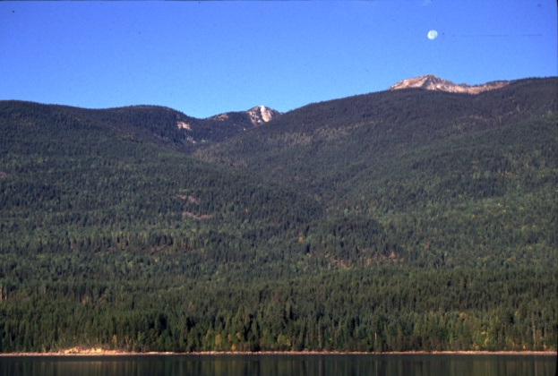
Visual Quality Objectives
Preservation:
Alteration, when assessed from a significant public viewpoint, is:
very small in scale, and
not easily distinguishable from the pre-harvest landscape.
Predicted by 0% alteration of perspective landform.

Slide 11
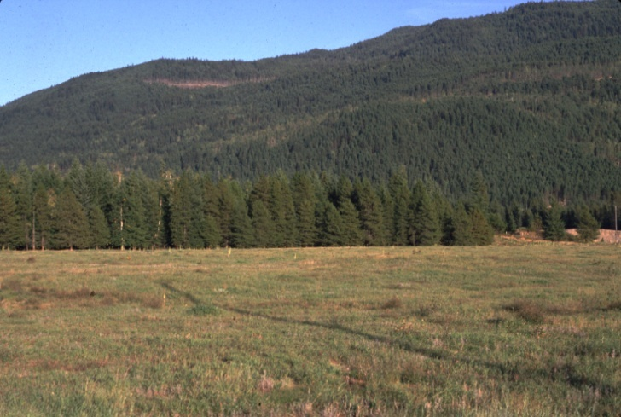

Visual Quality Objectives
Retention:
Alteration, when assessed from a significant public viewpoint, is:
(i) difficult to see,
(ii) small in scale, and
(iii) natural in appearance.
0.3%
Predicted by 0 - 1.5% alteration of perspective landform
0.9%

Slide 12
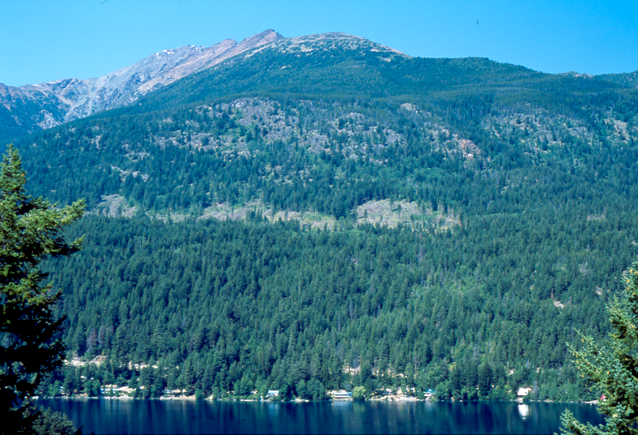
Visual Quality Objectives
Partial Retention:
Alteration, when assessed from a significant public viewpoint, is
(i) easy to see,
(ii) small to medium in scale, and
(iii) natural and not rectilinear or
geometric in shape.
3.1%
Predicted by 1.6 - 7.0% alteration
of landform in perspective.
5.3%

Slide 13

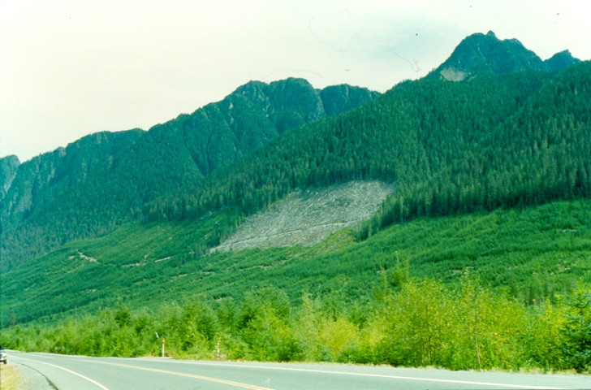
Visual Quality Objectives
Modification:
Alteration, when assessed from a significant public viewpoint, is
is very easy to see, and
is (A) large in scale and natural in its appearance, or (B) small to medium in scale but with some angular characteristics.
5.9%
7.3%
Predicted by 7.1 – 18.0% alteration

Slide 14
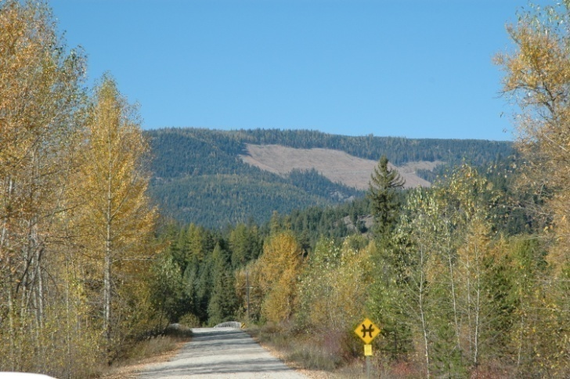
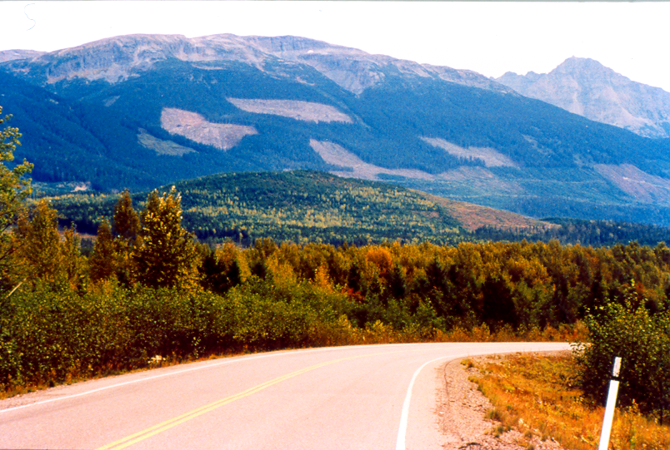
Visual Quality Objectives
Maximum Modification:
Alteration, when assessed from a significant public viewpoint, is
very easy to see, and (ii) is
(A) very large in scale,
(B) rectilinear and geometric in shape, or
(C) both.
19.0%
11.8%
Predicted by 18.1 – 30.0 % alteration

Slide 15
1, 2
Previous monitoring ... Forest & Range Evaluation Program (FREP)
Campbell River Dist. (14 samples) 86% conformance (2 non-conforming)
Sunshine Coast Dist. (8 samples) 87% conformance (1 non-conforming)
Compared to:
Coast Area (102 samples) 82% conformance
Province FPC 63% FRPA 69%
_________________________________
FREP- based on random sampling.
Sampling done under both Forest Practices Code & FRPA.

Slide 16
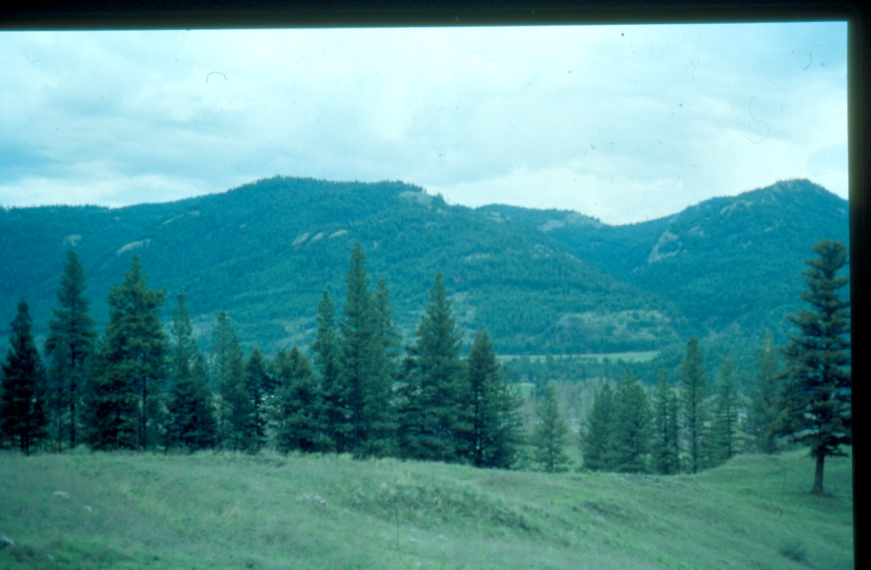
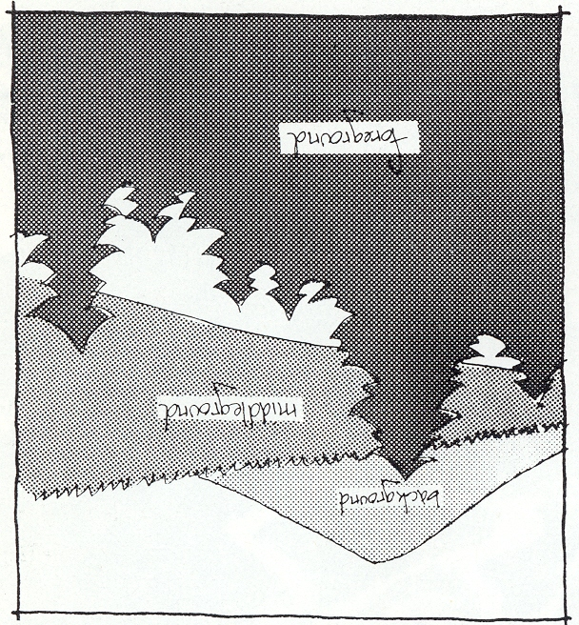
Understanding the Landscape
The existing VRM Program was developed to address alterations on the mid-ground & background landscapes.
More than 8 Km
Background
Middleground
Midground
1- 8 Km from viewer
Foreground
0-1 Km from viewer
Preliminary research has been conducted on managing the foreground views.

Slide 17
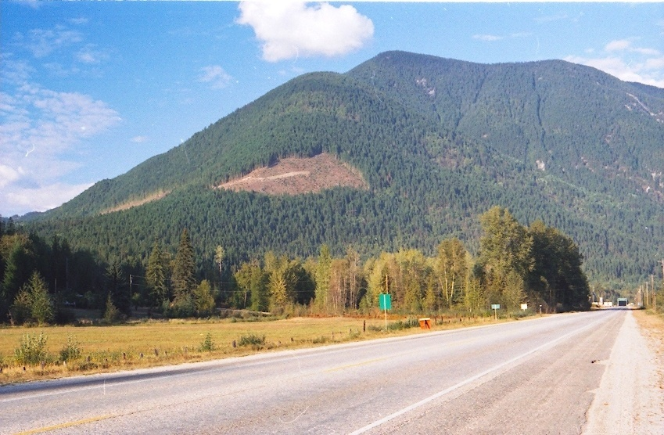
Landscape versus Landform
MFLNRO manages alterations on landforms as opposed to the total landscape scene.
Background or adjacent landforms not Included
Landform outlined in yellow
Foreground Not included
Landform: a distinct topographic feature that is three dimensional in form and is generally
defined by ridges, valleys, shorelines and skylines. Examples include hills and mountains.
Majority of the time landforms are reasonably easy to define.

Slide 18
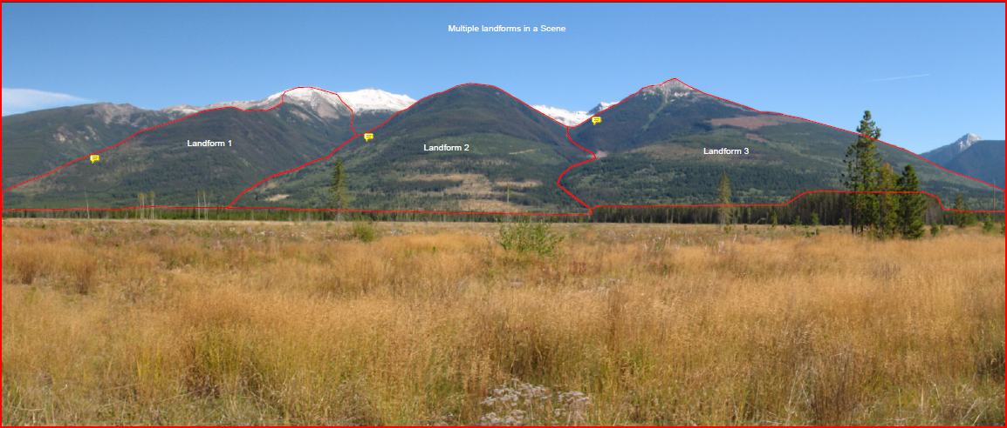
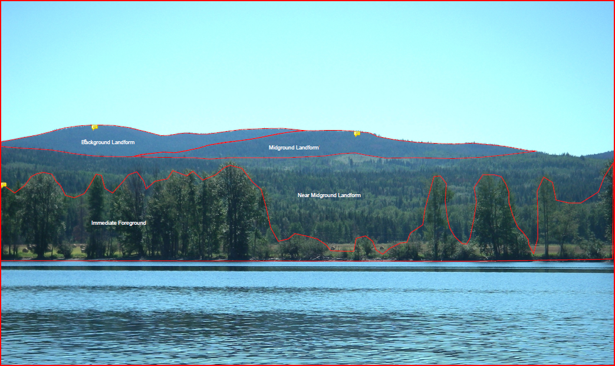
Distinct Landforms in Vertical Landscape
Layered Landforms in Horizontal Landscape

Slide 19
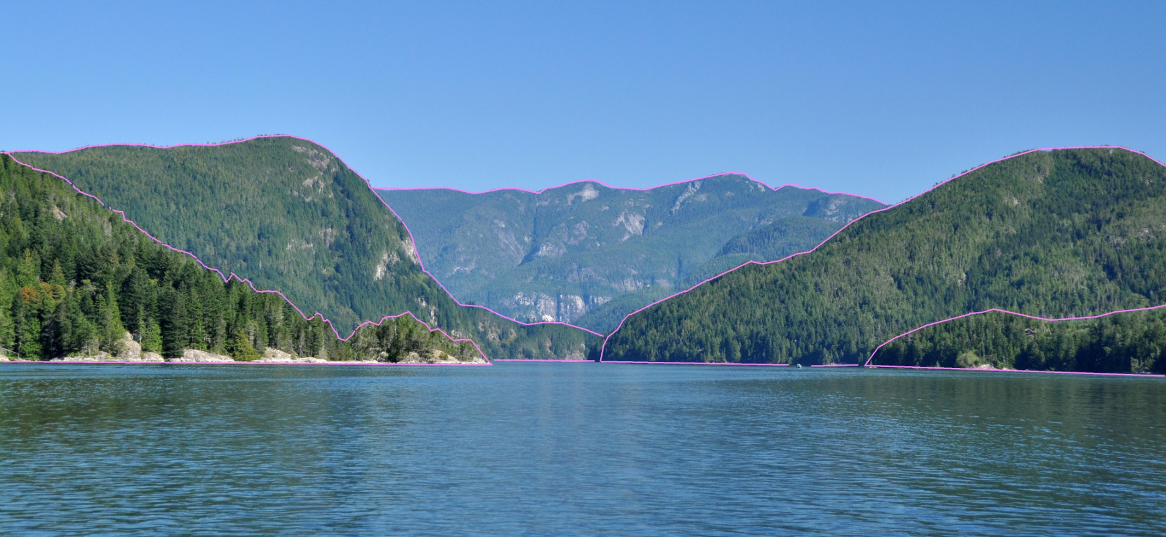
VQOs are assessed relative to individual landforms as opposed to sweeping panoramic landscape scenes composed of multiple landforms.
middleground 1
background
middleground 2
foreground
Western entrance to Hole in the Wall passage

Slide 20
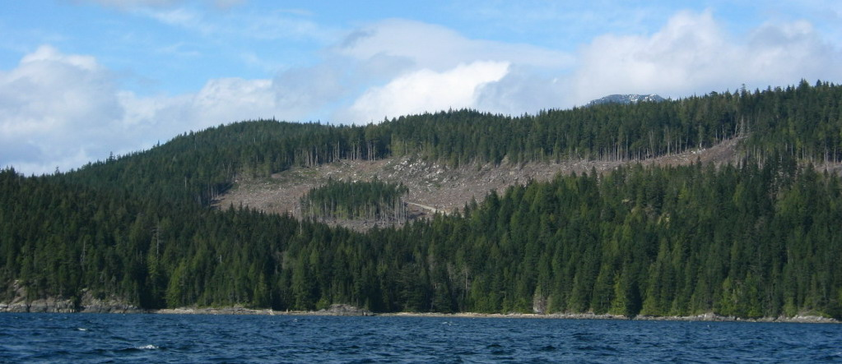
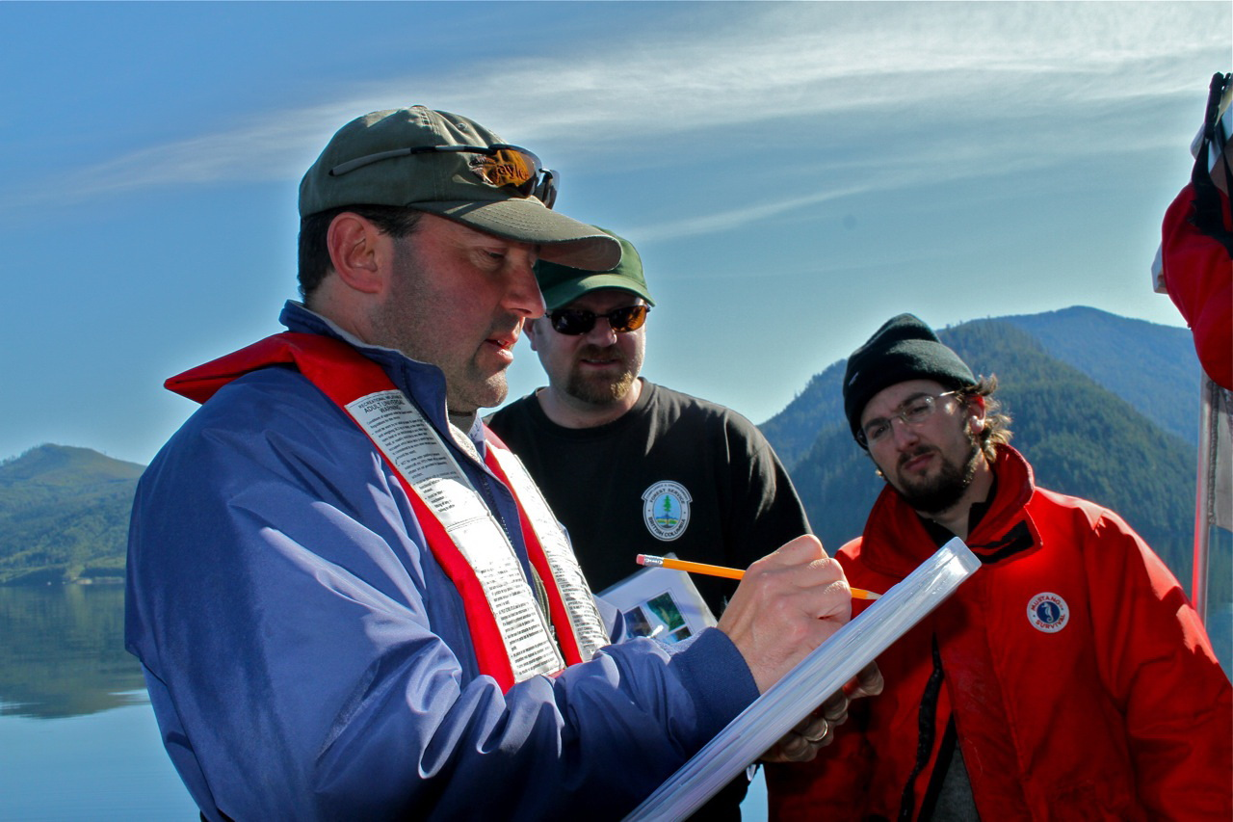
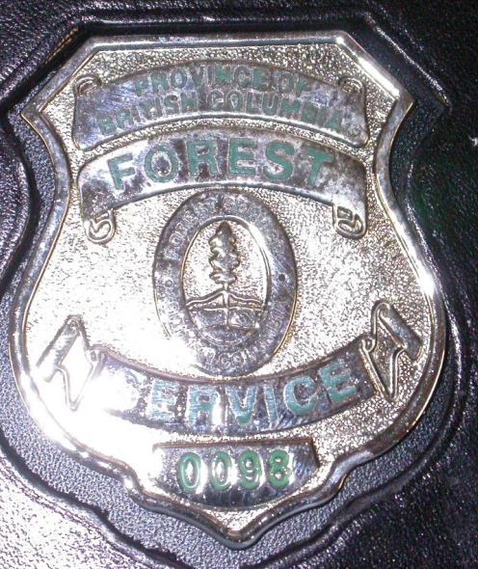

VQO Conformance versus Compliance
Conformance is defined as “acting in accordance with specified standards or authority”. In the context of resource stewardship monitoring it refers to meeting the VQO legal definitions (Categories of visually altered landscape, FPPR section 1.1) and following visual design concepts. Scale of landform alteration is secondary. Conformance monitoring is central to the Forest & Range Evaluation Program.
Compliance is defined in part as “the act or process of complying” and “conformity in fulfilling official requirements”. The MFLNRO interprets “To be in compliance” means the activity is meeting all statutory requirements of relevant standards, regulations, and acts. In the context of visual resource management, Compliance & Enforcement staff is responsible for ensuring the legal commitments of approved Forest Stewardship Plans are met.
VQO monitoring
C&E

Slide 21
Discovery Islands Monitoring Results
(based on 95 selected stops)
1
District conforming borderline non-conforming
Campbell River 36 9 4
Sunshine Coast 39 4 3
Totals:
79% conformance
14% borderline
7.5% non-conformance
________________________
1.
Borderline used to describe forest harvesting towards the upper alteration limit of the VQO class in terms of its legal definition, design, and/or scale of landform alteration.

Slide 22
Photographic Examples
1. Conforming 2. Borderline 3. Non-conforming
Stop 1 Herriot Bay, Quadra Is., natural appearing, PR VQO.
Stop 2 Open & Hyacinth Bay, mix of foreshore private, R-PR-M VQOs.
P
R
PR
M
MM
______________________________________________
l
l
l
l
l
l
l
l
l
l
l
l
l
l
l
l
l
l
l
l
l

Slide 23
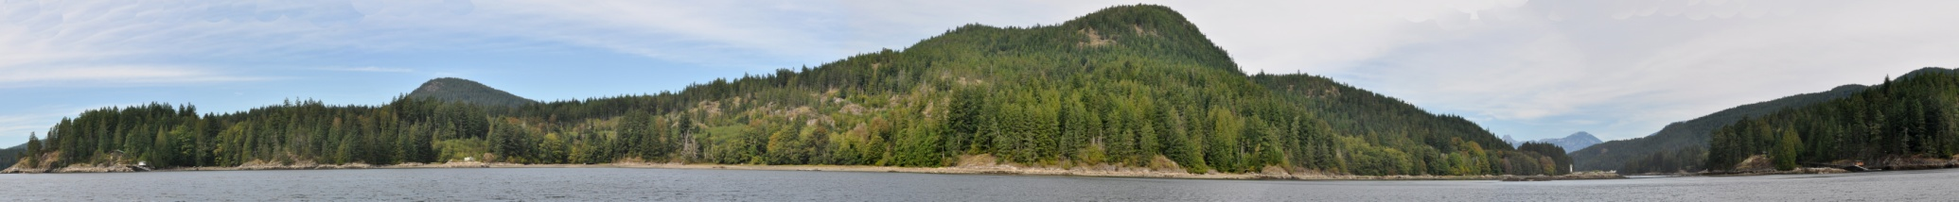
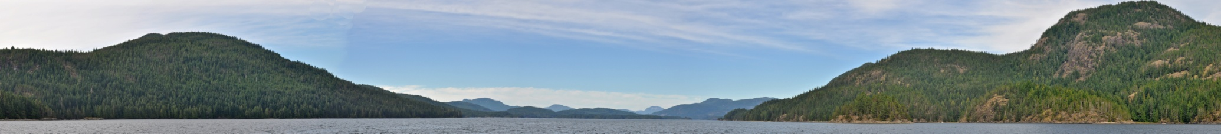
Conforming.....
Stop 7 Whiterock Passage western entrance. Privateland greening-up, Crownland Retention VQOs.
Stop 10 Okisollo Channel viewing north. Natural appearing. Good conformance to R & PR VQOs.
P
R
PR
M
MM
______________________________________________
l
l
l
l
l
l
l
l
l
l
l
l
l
l
l
l
l
l
l
l
l

Slide 24
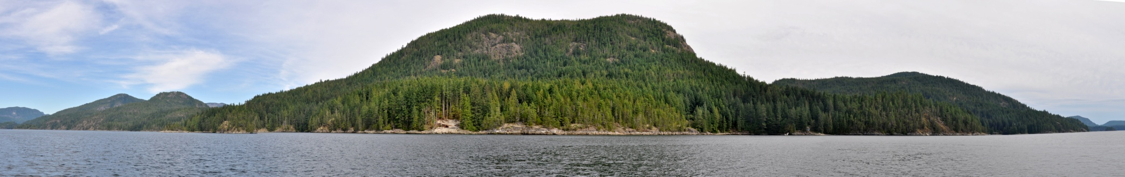
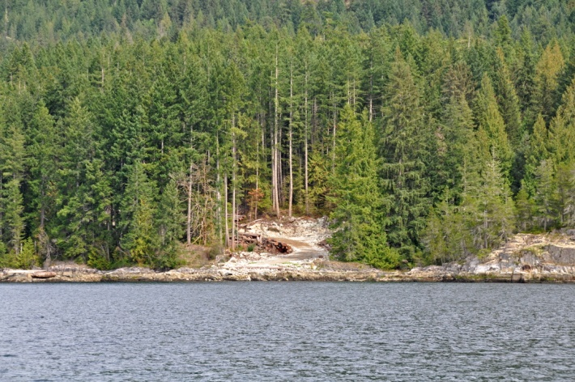
Conforming.....
Stop 12. Maurelle Is. from Okisollo Ch. BCTS barge/grid visible on shoreline, conforming to PR VQOs from mid-channel.
Close-up view of BCTS log barge/grid. Narrow width and trees retained to minimize visual impact. Eliminates need for log booming and associated industrial activates.
P
R
PR
M
MM
______________________________________________
l
l
l
l
l
l
l
l
l
l
l
l
l
l
l
l
l
l
l
l
l

Slide 25
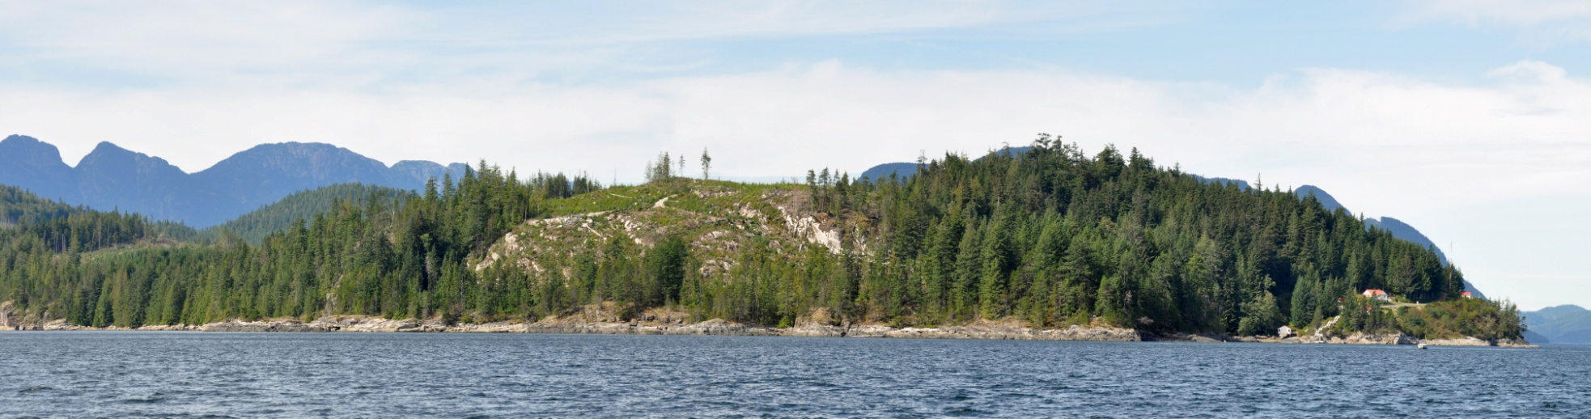
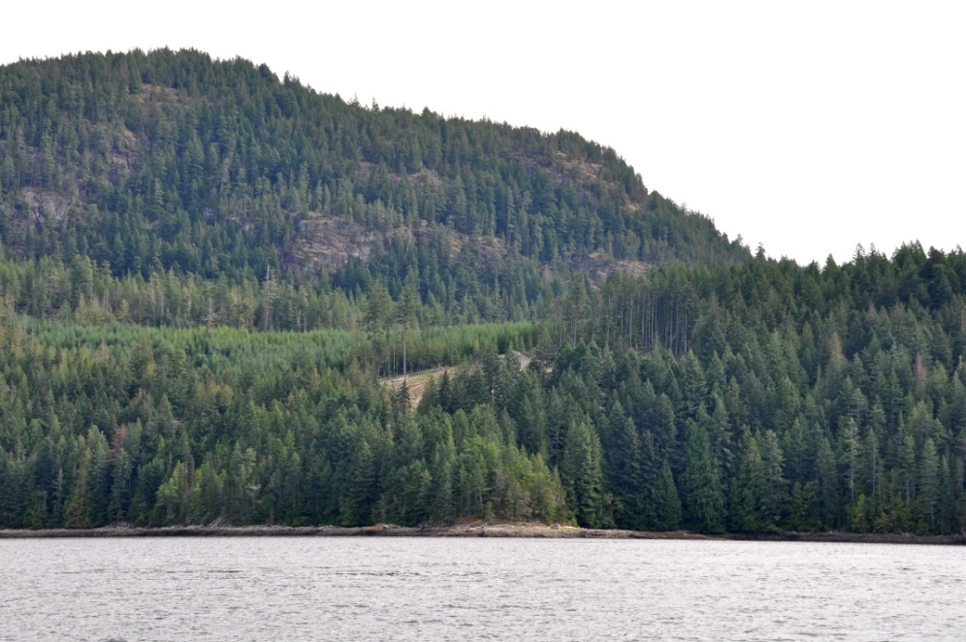
Visual impacts of privateland logging (no VQOs)
Stop 34 Chatham Pt. Significant visual impact to foreground is slowly beginning to soften.
Stop 6. Hoskyn Channel privateland logging. Cutblock keep small appearing and foreshore forest was retained to minimize visual impact.

Slide 26
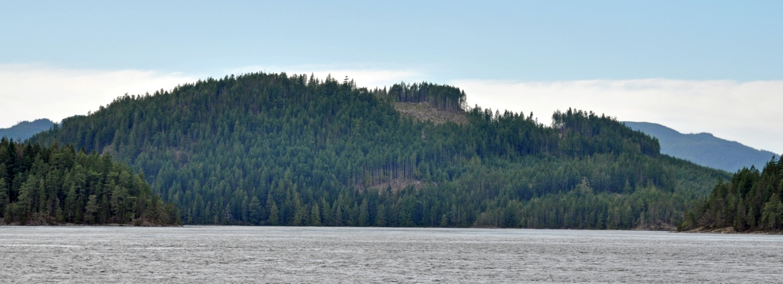
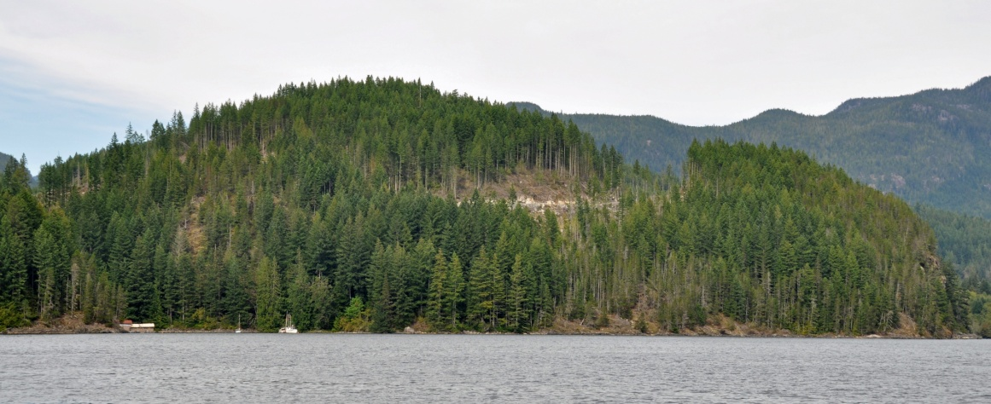
Conforming.....
Stop 21. Sonora Is. north of Owen Bay. TFL 47. Cutblocks small, natural shapes
Stop 20. Owen Bay, Sonora Island. Small appearing and not angular.
P
R
PR
M
MM
______________________________________________
l
l
l
l
l
l
l
l
l
l
l
l
l
l
l
l
l
l
l
l
l

Slide 27
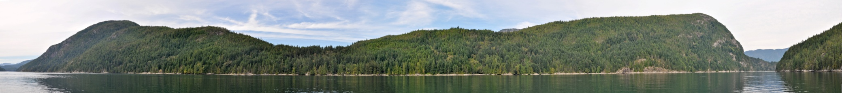
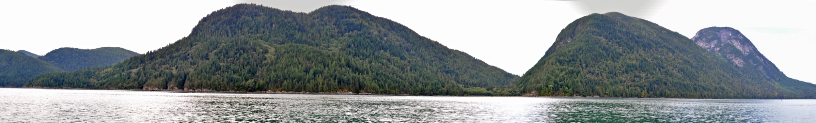
Conforming.....
Stop 14. Sonora Is. viewed from midway Hole in the Wall passage. Good conformance to Retention VQOs.
Stop 17. Sonora Is. seen from Calm Channel. Natural appearing, conforming to PR VQOs.
P
R
PR
M
MM
______________________________________________
l
l
l
l
l
l
l
l
l
l
l
l
l
l
l
l
l
l
l
l
l

Slide 28
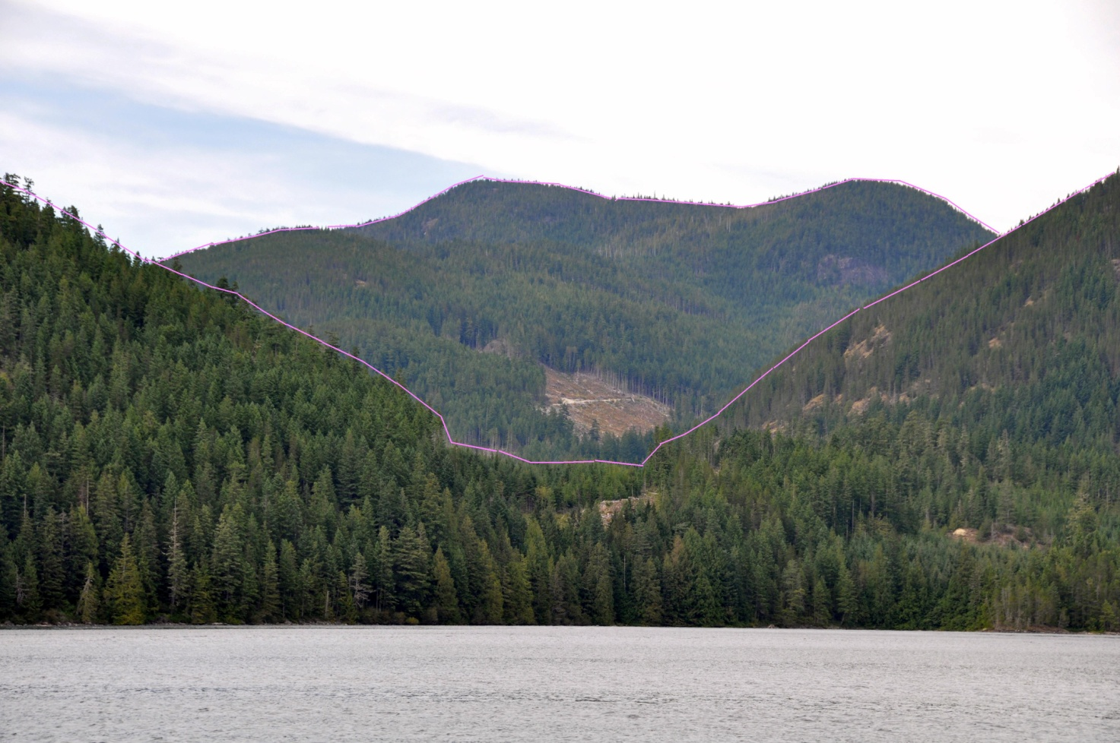
Stop 23. Sonora Is. east of Woods Bay, excellent example of Partial Retention VQO. Relatively small, rounded, no angularity, appropriate scale.
P
R
PR
M
MM
______________________________________________
l
l
l
l
l
l
l
l
l
l
l
l
l
l
l
l
l
l
l
l
l

Slide 29
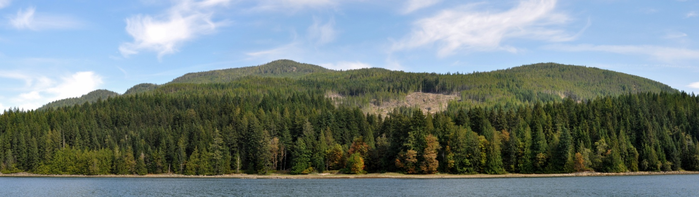
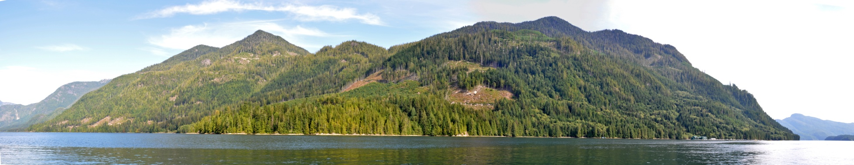
Conforming.....
PR VQOs.
Stop 35. Sonora Is., Chameleon Hbr, TFL 47, Good visual design & beneficial in-block tree retention.
Stop 46. Cordero Channel, TFL 45, PR VQO, medium in relative scale, no obvious angular lines.
P
R
PR
M
MM
______________________________________________
l
l
l
l
l
l
l
l
l
l
l
l
l
l
l
l
l
l
l
l
l

Slide 30
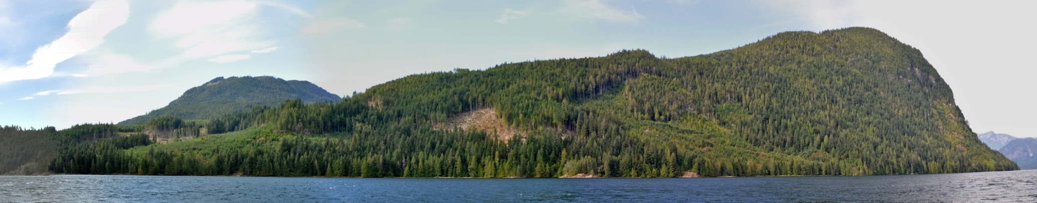
Conforming.....
Stop 49. Cordero Channel. PR VQO. Relatively small appearing block, good natural shape, visually effective green-up helps reduce cumulative impact.
P
R
PR
M
MM
______________________________________________
l
l
l
l
l
l
l
l
l
l
l
l
l
l
l
l
l
l
l
l
l

Slide 31
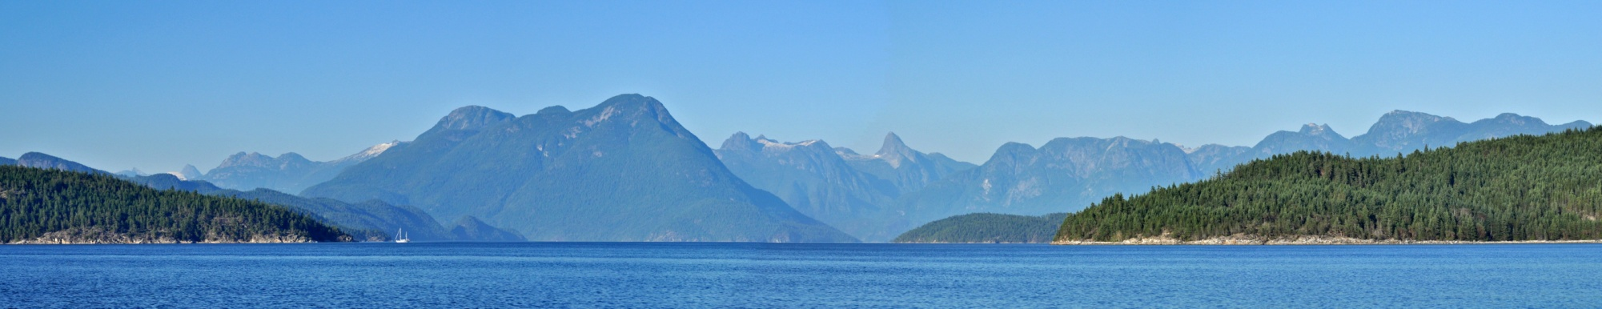
Conforming..... (Sunshine Coast District)
Stop 67. Near Sarah Pt. Malaspina Channel, scenically attractive and natural appearing landscapes.
P
R
PR
M
MM
______________________________________________
l
l
l
l
l
l
l
l
l
l
l
l
l
l
l
l
l
l
l
l
l

Slide 32
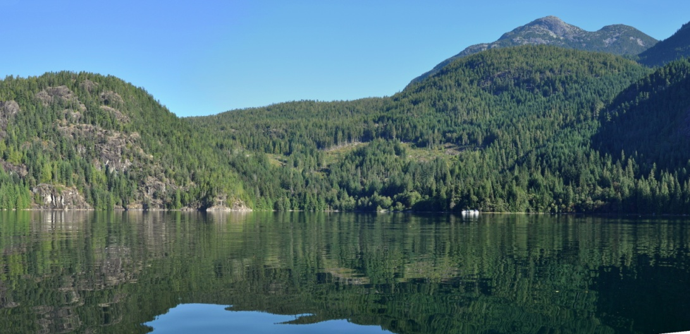
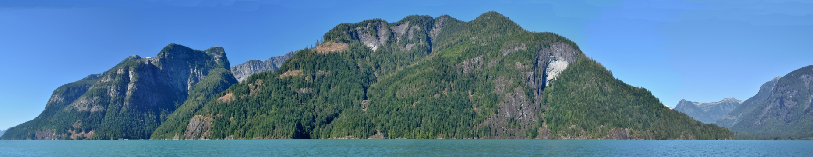
Stop 70. Atwood Bay, BCTS cutblock, PR VQO. Visually well designed showing natural shapes and in-block tree retention. Excellent example of meeting PR VQO.
Stop 73. Extremely scenic landform, Toba Inlet. Small dispersed heli blocks. Good conformance to PR VQO.
P
R
PR
M
MM
______________________________________________
l
l
l
l
l
l
l
l
l
l
l
l
l
l
l
l
l
l
l
l
l

Slide 33
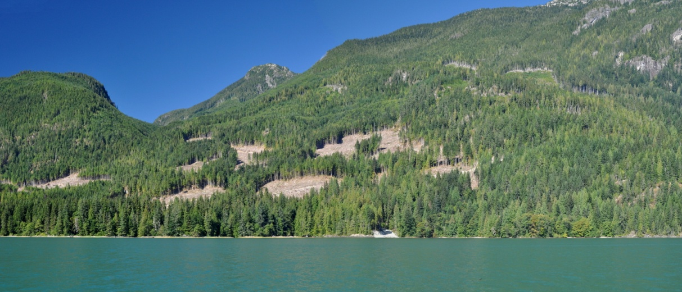
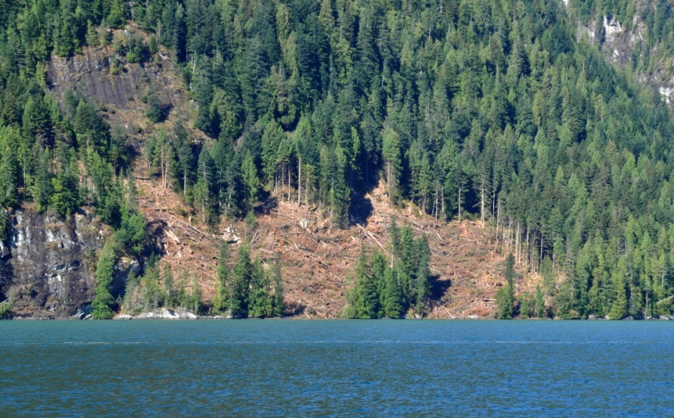
Stop 79. Toba In. heli-logging. Good cut/leave pattern meeting the PR VQO.
Stop 75. Toba Inlet heli logging. Good visual design. Foreshore reserve has visual benefit. Could be more substantial to ensure windfirm.
P
R
PR
M
MM
______________________________________________
l
l
l
l
l
l
l
l
l
l
l
l
l
l
l
l
l
l
l
l
l

Slide 34
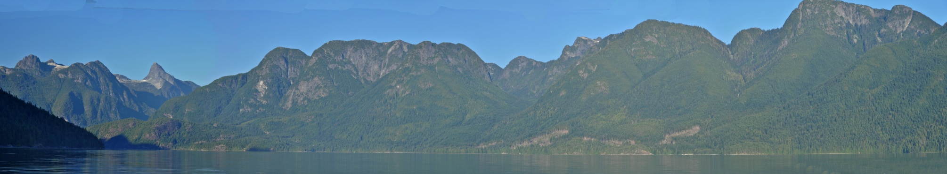
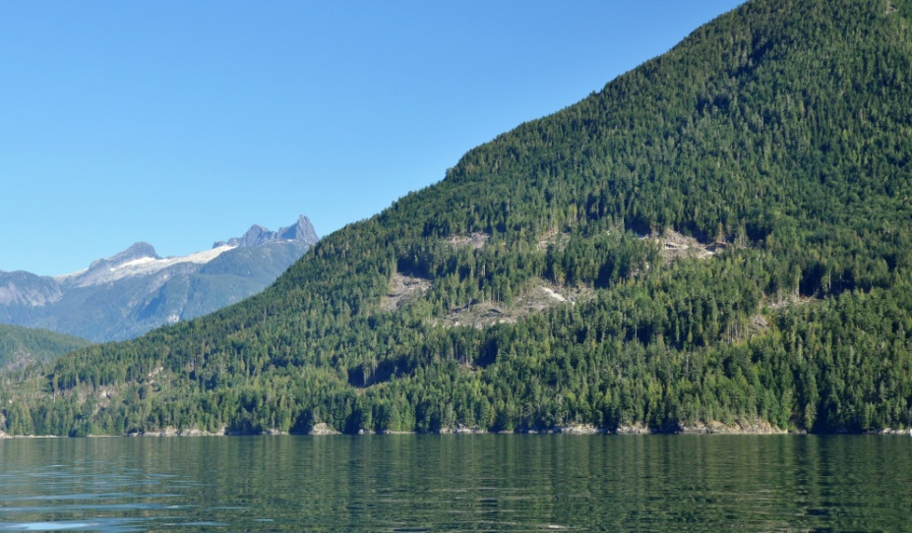
Stop 102 Homfray Channel. Harvesting concentrated on lower slopes, conforming to PR VQO.
Stop 98 East Redonda Is. Radial in-block tree retention assists with meeting Partial Retention VQO.
P
R
PR
M
MM
______________________________________________
l
l
l
l
l
l
l
l
l
l
l
l
l
l
l
l
l
l
l
l
l

Slide 35

Conforming.....
Stop 124. Evans Bay, Read Island. Small naturally shaped cutblock & in-block tree retention ensures it is difficult to see. Conforming to the Retention VQO.
P
R
PR
M
MM
______________________________________________
l
l
l
l
l
l
l
l
l
l
l
l
l
l
l
l
l
l
l
l
l

Slide 36

1. Conforming 2. Borderline 3. Non-conforming
Stop 29 Sonora Is. from Okisollo Ch., some degree of angularity. Greater in-block retention and increase in foreshore reserve would have benefited.
P
R
PR
M
MM
______________________________________________
l
l
l
l
l
l
l
l
l
l
l
l
l
l
l
l
l
l
l
l
l

Slide 37


PR VQO
Sonora Is. , Green Sea Bay, BCTS, some degree of angularity & cumulative visual impact.
Phillips Arm, TFL 45, seen from Cordero Channel. Recent cutblock while relatively small in scale has some obvious angular characteristics.
PR VQOs.
P
R
PR
M
MM
______________________________________________
l
l
l
l
l
l
l
l
l
l
l
l
l
l
l
l
l
l
l
l
l

Slide 38


Borderline Partial Retention
Cordero Ch. W. of Cordero Lodge. TFL 47. Moderate to large in scale but no angular characteristics.
Loughborough In., Modification VQO. Large scale, straight boundaries, angular characteristics
P
R
PR
M
MM
______________________________________________
l
l
l
l
l
l
l
l
l
l
l
l
l
l
l
l
l
l
l
l
l

Slide 39

Borderline...
Stop 76. Toba Inlet heli-block, PR VQO, small in relative scale of alteration, angular unnatural design.
P
R
PR
M
MM
______________________________________________
l
l
l
l
l
l
l
l
l
l
l
l
l
l
l
l
l
l
l
l
l

Slide 40

Borderline...
(Partial Retention VQO)
Stop 96 Bute Inlet. Cumulative impact verging on Modification. Important to allow sufficient green-up between adjacent harvests.
P
R
PR
M
MM
______________________________________________
l
l
l
l
l
l
l
l
l
l
l
l
l
l
l
l
l
l
l
l
l

Slide 41

1. Conforming 2. Borderline 3. Non-conforming
Stop 30 Sonora Island, west entrance to Okisollo Channel. PR VQO. TFL 47. Very easy to see foreground harvesting , large appearing scale due to short viewing distance, ridge/skyline is interrupted, and obvious road cut.
Compare & contrast with Partial Retention ------ >
P
R
PR
M
MM
______________________________________________
l
l
l
l
l
l
l
l
l
l
l
l
l
l
l
l
l
l
l
l
l

Slide 42


Stop 41 Frederick Arm from Cordero Channel.
(Partial Retention VQO)
Approved FSP allows for Modification VQO from secondary viewpoints within Frederick Arm. Therefore it is not a non-compliance.
Whale watching charter boat
P
R
PR
M
MM
______________________________________________
l
l
l
l
l
l
l
l
l
l
l
l
l
l
l
l
l
l
l
l
l

Slide 43

Phillips Arm, westside, mid-inlet. PR VQO. Approved FSP allows for Modification VQO from secondary viewpoints within Phillips Arm. Therefore it is not legally a non-compliance.
P
R
PR
M
MM
______________________________________________
l
l
l
l
l
l
l
l
l
l
l
l
l
l
l
l
l
l
l
l
l

Slide 44

Stop 82 Pryce Channel. Original harvesting had a significant negative visual impact. C&E investigation found harvesting in non-compliance to the Partial Retention VQO.
P
R
PR
M
MM
______________________________________________
l
l
l
l
l
l
l
l
l
l
l
l
l
l
l
l
l
l
l
l
l

Slide 45

Stop 86 Head of Ramsay Arm. PR VQO. Very easy to see from foreground & middleground viewing distances. Medium in scale with angular characteristics. Resulting in a Modification visual quality class.
P
R
PR
M
MM
______________________________________________
l
l
l
l
l
l
l
l
l
l
l
l
l
l
l
l
l
l
l
l
l

Slide 46


Stop 89 Stuart Island, Partial Retention VQOs. Distant view from Johnstone Bluff. Even at distance the harvesting is very easy to see, appears very large, and unnatural shape.
Stop 90 Mid-channel viewpoint. Main tourist travel c0rridor. Some straight and angular boundaries are present. Linear layout has effectively bisected the landform creating strong visual tension. Very easy to see from many locations. In-block tree retention is minimal.
P
R
PR
M
MM
______________________________________________
l
l
l
l
l
l
l
l
l
l
l
l
l
l
l
l
l
l
l
l
l

Slide 47
Summary
Review found high level of VQO conformance.
Results reflect earlier FREP random monitoring results.
Found a significant number of borderline situations where harvesting is verging towards non conformance to the VQO definition. Visual impact being towards the maximum level of development for the VQO class.
Lack of visual design (not scale) tends to be responsible.
In a few locations the cumulative visual impact of various harvest blocks is contributing.
Small number (6) of VQO non conformances reported.
In combination, borderline & non-conformances are potential sources of negative public & tourism stakeholder criticism.

Slide 48
Recommendations
To ensure greater conformance to VQOs forest licensees need to put more emphasis on visual design. Less emphasis on scale of alteration guidelines.
Forest licensee staff/foresters practicing in visually sensitive landscapes need to acquire & maintain skill in visual resource management. Alternatively employ qualified consultants.
Licensees may need to consider a wider range of professional peer review of their forest development plans when operating in important scenic areas.
Licensees to continue using robust visual impact assessment procedures. When in doubt, confirm viewpoints with MFLNRO.
Pay greater attention to the cumulative visual impact of harvesting over time. (allowing for adequate VEG green-up)

Slide 49
Recommendations- continued
In highly sensitive marine tourist corridors/viewpoints, operate at the restrictive end of the VQO’s spectrum rather than maximum allowed alteration.
Licensees would benefit from cooperative information sharing with potentially affected public/recreation/tourism stakeholders to help resolve visual management concerns.
Digital (website) information sharing of pre-harvest visual impact assessments should be explored.
Tourism sectors also need to work cooperatively with forest companies to resolve or accommodate their interest in maintaining scenic quality.

Slide 50


Questions ?
Lloyd Davies, RPF
Visual Resource Management Specialist
Ph. 250-751-7112
email: Lloyd.Davies@.gov.bc.ca

Slide 52
P
R
PR
M
MM
______________________________________________
l
l
l
l
l
l
l
l
l
l
l
l
l
l
l
l
l
l
l
l
l

